Slide 1
RLI 1 2022 (Batch 3)
MY LEADERSHIP IN ROTARY

Slide 2
As a Rotarian
I am
by definition,
a leader

Slide 3
Session Goals
On completion of this session, I will be able to:
Discuss the characteristics of leadership
Discuss what motivates people in a volunteer or civic organization
Examine my own leadership style

Slide 4
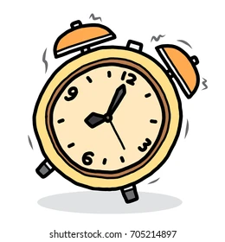
Time Frame: 70 minutes
Discussion: 25 minutes
Breakout: 20 minutes
Reporting out: 15 minutes
Wrap-up: 5 minutes

Slide 5
Resources
On Line:
The Basics for Effective Leadership are Really Pretty Basic
12 Leadership Essentials for the 21st Century

Slide 6
Is there a Difference?
Leadership in Business –vs – Leadership in Rotary?
What is the role of a Leader in Rotary?
Volunteer Organization
Followers are not employees / subordinates
Service motivation –vs– Profit motivation

Slide 7
Characteristics
What are the characteristics of Good Leaders?
What do you think are the most important?
 | Vision |  | Haphazard
 | Stubbornness |  | Courage
 | Know-it-all |  | Respect
 | Secretive |  | “Everything urgent”
 | Trustworthy |  | Good comms skills
 | Overbearing |  | Respect
 | Humility |  | “Washes hands”

Slide 8
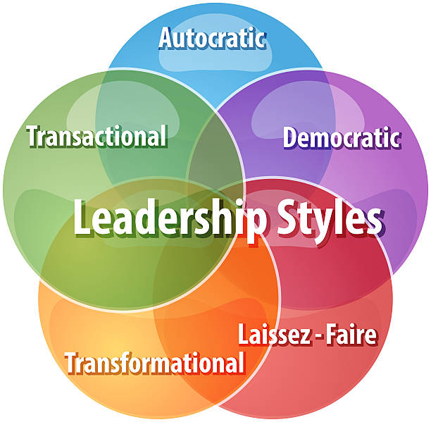
Leadership Styles
Leadership styles differ by culture and
generation. What style do you feel best
fits you?
Participative
Situational
Transactional
Transformational
Servant

Slide 9
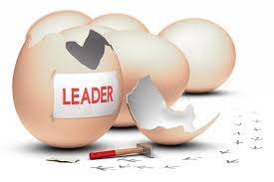
Born or Taught?
Are Good Leaders born? Or can Leadership be Taught?

Slide 10
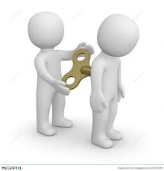
Motivation
What motivates someone to excel:
In the Workplace
In your Rotary club

Slide 11
Breakout - 20 minutes
Task:
Think about Presidents in your club.
Select who you think was the BEST LEADER (no names please).
Tell the group why that leader was the best.
What seems to be the most significant difference between strong and weak Rotary Club leaders?

Slide 12
Reporting Out
Summarize the discussion in your group
(5 minutes / group)

Slide 13
Summary
Good leadership requires
Thought
Planning
Preparation
Willingness to try something new
Not being bound by the past
Confidence to take risks

Slide 14
Thank you for sharing with me.

