Slide 2
THE BASICS OF BRANDING

Slide 3
What is a brand?
A brand is a name, logo, or symbol that evokes in customers a perception of added value for which they will pay a premium price.

Slide 4
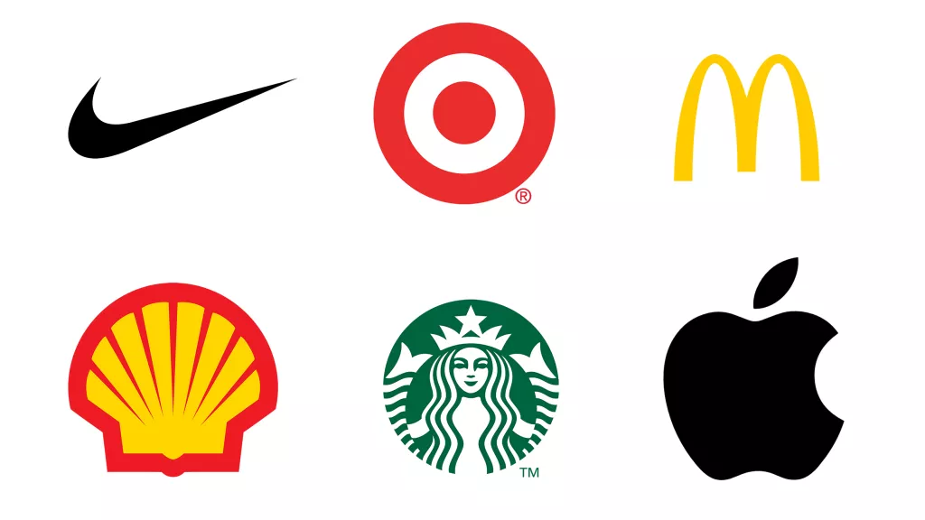
?
?
?
?
?
?
When the square is removed, call out a word that describes
what is revealed. YOU CANNOT NAME THE OBJECT ITSELF

Slide 5
KEY BRAND ELEMENTS
BRAND NAME – your name, tagline, logo
BRAND PROMISE – the single most important thing you promise to deliver all the time
BRAND PERSONALITY – what you want to be known for (ex: informative, fun, serious, etc.)
BRAND ASSOCIATIONS – colors, taglines, fonts, images, or anything that tends to remind people of you.

Slide 6
ADVANTAGES OF A STRONG BRAND
Improved perceptions of the product
Greater loyalty
Greater customer engagement
Less vulnerability to fluctuations in the product environment
Increase marketing effectiveness

Slide 7
WHAT IS BRANDING?
MARKETING
BRANDING
COMPANY/
ORGANIZATION
CONSUMER
DESIGN
Branding is the combined effort of the company which is projected to the consumer.

Slide 8
BRAND INTEGRITY
PRODUCT A
WEBSITES / SOCIAL MEDIA
PACKAGING
COMPANY/ ORGANIZATION
LOGO
PRODUCT B
MARKETING
A brand is a promise to achieve certain results, to act in a certain way, or deliver a certain experience. It is a promise expressed in what you do and how you do things.

Slide 9
LET’S PLAY!
1
4
If your brand was an animal, what would it
be and why?
If your brand was a superhero, what would its power/s be? And who would be its archnemesis?
2
How would your brand change if it were taken over by a big brand?
3
At the end of the year, your brand is front page news! What does the headline say? What have you done to get there?

Slide 10
THE BASICS OF BRANDING

